Slide 1
March Madness Week 2
Math Corners and
Constructed Response
OA4-6, NBT2, MD3-4

Slide 2

Math Corner-Multiplication & Division
Young Scholars Day Care has 6 Pre-K classes. If there are 14 students in each class, use 3 different strategies to determine the product.

Slide 3
Constructed Response
-Multiplication & Division
Corey, Jamal, and Austin have markers.
Part A
If they each had 9, how many markers do they have combined?
Part B
How many more will they need to have 100 markers?
Part C
Corey’s sister wants to borrow 5 from each person. How
many markers do the boys have now?

Slide 4
Math Corner-Multiplication & Division
At the Fall Festival, Donna is polishing finger nails. So far, she has polished eight hands. How many FINGERNAILS has she polished so far? Solve your problem two different ways.

Slide 5
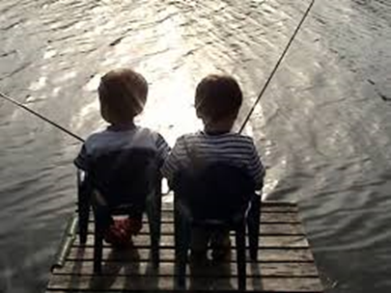
Constructed Response
-Multiplication & Division
Peter goes fishing with Danny. Danny catches 4 big fish and 4 small fish.
Part A
If Peter catches six times as many fish as Danny, how many fish did Peter catch?
Part B
Henry has twice as many fish as Peter. Explain a strategy to find out how many fish Henry has.

Slide 6

Math Corner-Multiplication & Division
Solve this problem with pictures and words.
Mrs. Guyton bought eight six packs of soda. How many thirsty children can have one of Mrs. Guyton’s drinks?
Challenge: If you wanted to check to see if your answer was correct, what inverse operation could you use?

Slide 7
Math Corner-Multiplication & Division
Lane collects stamps in an album. Eight stamps can fit on a page. So far, she has four pages filled.
Part A
How many stamps does Lane have in her collection? Can you solve the problem two different ways?
Part B
Her goal is to collect 100 stamps. How many more stamps does she need to collect to reach her goal?

Slide 8
Constructed Response
-Multiplication & Division
Mr. Hill wrote the following equation: 48 ÷ __ = 6
Part A
What model could you draw to solve for the missing number?
Part B
What do you know about multiplication that could help you prove your thinking?
Part C
Explain how you could use a number line to solve the equation.

Slide 9
Math Corner-Multiplication & Division
Solve with pictures and numbers. There are 41 doughnuts. Eight friends will share the doughnuts equally. How many doughnuts will each friend get? What else do you notice?
Challenge! Can you solve it one more way?

Slide 10
Constructed Response
-Multiplication & Division
Ms. Holmes wrote the following expression on the board. 3 x (2 x 4)
Part A
Using words3 x, explain what this expression is telling you to do.
Part B
Using a model, draw a picture to represent the expression.
Part C
How is this expression 4 x (3 x 2) different or similar to the one Ms. Holmes wrote? What is another way to write this expression?

Slide 11
Math Corner-Multiplication & Division
The magic number is: 45
Figure out a way to reach this number using:
Repeated addition
Array models
Skip counting on a number line
Equal grouping
Explain how multiplication and division can be used to reach this number using inverse operations.

Slide 12
Constructed Response
-Multiplication & Division
Ms. Lorrie bought boxes of crayons for her students.
Part A
On Monday, she bought boxes for 6 students. Each box has 8 crayons. How many total crayons did she buy?
Part B
How many crayons would there be in 8 boxes?
Part C
By Friday, she bought a total of 88 crayons. How many students had new crayon boxes?

Slide 13
New Standard

Slide 14
Math Corner-+/- within 1000
John says that 156-23= 160-27.
His sister Sheila says that it’s not true.
Who do you agree with? What explain your thinking by using at least two different strategies.

Slide 15
Constructed Response-+/- within 1000
Tickets for a play cost $8 each. On Friday, 378 tickets were sold. On Saturday, 544 tickets were sold.
Part A
What is the difference between the number of tickets sold on Friday and the number of tickets sold on Saturday? Show your work.
Part B
On Sunday, 80 more tickets were sold than the number of tickets sold on Friday. How much more money was made on Sunday than Friday? Show your work.
Part C
What is the total number of tickets sold on Friday and Sunday? Show your
work.
.

Slide 16
Math Corner- +/- within 1000
There were 328 girls and 235 boys on our school
playground at recess.
How many children were there on the playground at recess?
If our school has 139 teachers, how many students and teachers are there in the school?

Slide 17
Constructed Response-+/- within 1000
Ms. Smothers has a fictional book with 814 pages. You decide you are up to the challenge and check it out to read over Spring Break.
Part A
On Monday you read 39 pages. How many more pages do you have to read?
Part B
By Wednesday you read up to page 188. How many more pages do you have to read now?
Part C
If your goal was to read up to 1000 pages, how many more would you need to read? How can you prove your thinking?

Slide 18

Math Corner- +/- within 1000
Mrs. Smothers purchased 820 new library books this year. 568 of the new books are fiction. How many of the new books are not fiction? Show your thinking.

Slide 19
Constructed Response +/- within 1000
Kareem had the following scores playing a video game.
Part A
Find the sum of Kareem’s scores. Show your work.
Part B
Round each of Kareem’s scores to the nearest 10. Explain what process you used to round each of the scores.
Part C
Find the sum of the rounded scores in Part B. Show your work.
Part D
Kareem wants to have a sum of 595 points. How many more does he need?
Show your work.

Slide 20
Math Corner- +/- within 1000
Phineas Elementary School has 675 students and 80 teachers. Ferb Elementary School has 239 more students than Phineas Elementary School has.
How many students are there at Ferb Elementary?
What is the difference in students the two schools have?
Challenge: Tell Phineas’ population in EXPANDED form. Tell Ferb’s population in EXPANDED form.

Slide 21
Constructed Response-+/- within 1000
Jackie has 876 pennies. She used 678 pennies to buy some balloons.
Part A
How many pennies does Jackie have left? Explain your thinking using words and pictures to show your work?
Part B
If Jackie didn’t spend her pennies, how many more coins would she need to have 1,000 pennies? How can you explain your thinking?

Slide 22
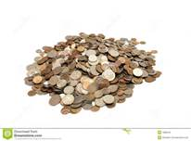
Math Corner-+/- within 1000
David saved 935 pennies. Michael saved 248 less pennies than David.
1. How much money did Michael save?
If David and Michael put their money together how many pennies would they have?
Explain the strategy that you used to prove your thinking.

Slide 23
Constructed Response-+/- within 1000
Peta solved wrote the following expression: 334 + 229
Part A
How would this expression look using place value models?
Part B
Explain how to use friendly numbers to solve the expression.
Part C
How would rounding these numbers give you an idea about the sum? Explain your thinking. What would these numbers be rounded to?

Slide 24
Math Corner-+/- within 1000
At Mike’s farm, there are six pigs, three ducks, two chickens, and one sheep.
Create a table and pictograph for this data. On your pictograph, each picture should represent two legs.
2. How many legs are at Mike’s farm? Solve this problem two ways.

Slide 25
Constructed Response +/- within 1000
A large park has 58 trees and 245 flowers.
Part A
Round the number of trees to the nearest 10. Show your thinking.
Part B
Round the number of flowers to the nearest 100. Show your thinking.
Part C
What is the total number of trees and flowers in the park? Show your work.
Part D
The park also has benches. The number of benches rounded to the nearest 10 is 30. How many benches could possibly be in the park?

Slide 27
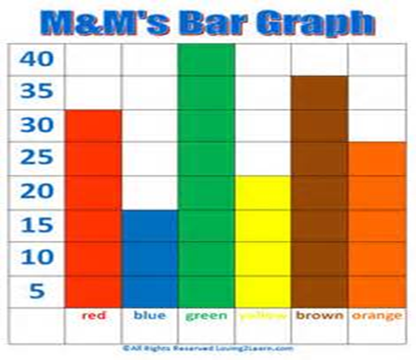
Math Corner-Measurement
The bar graph shows the number of colored M&M’s
in a large bag.
*have students to draw this graph in their journals
What scale was used on this M&M Bar Graph?
How would a pictograph look if the scale was 10?
What is the value of each color on the graph?
How many M&M’s are there altogether?

Slide 28
Constructed Response-Measurement
Use this table to complete the tasks below.
Part A
Create a bar graph to represent the information in the table.
Part B
Create a pictograph to represent the information in the table. Each symbol should represent 2.
Part C
In words, compare and contrast your two graphs.
Sunny | Cloudy | Rainy | Windy | Snowy
14 | 5 | 1 | 1 | 4

Slide 29
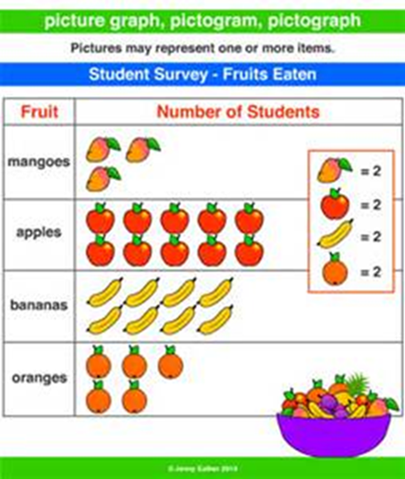
Math Corner-Measurement
What is the value of each fruit on the graph?
Create a bar graph to represent the data.
How many more students like apples
compared to mangoes?

Slide 30
Constructed Response -Measurement
Create a line plot using these numbers
1, 2, 4, 6, 7, 2, 4, 2, 6, 7, 1, 4, 2
Part A
Create a graph to model the data in a pictograph and bar graph.
Part B
Explain what do you notice about your data?
Part C
Which way do you prefer to model your data? Explain your thinking.

Slide 31
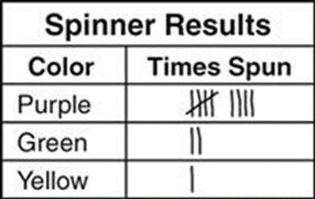
Math Corner-Measurement
If each tally mark represents a scale of 2, what is the value for each color on the graph?
If each tally mark represents a scale of 5, what is the value for each color on the graph?

Slide 32
Constructed Response-Measurement
Sofia made a picture graph to show how the students in her grade get to school each morning.
Part A
How many more students walk to school than ride the bus?
Part B
Represent this graph as a line plot.
Part C
How would the graph change if each face value was 10?

Slide 33
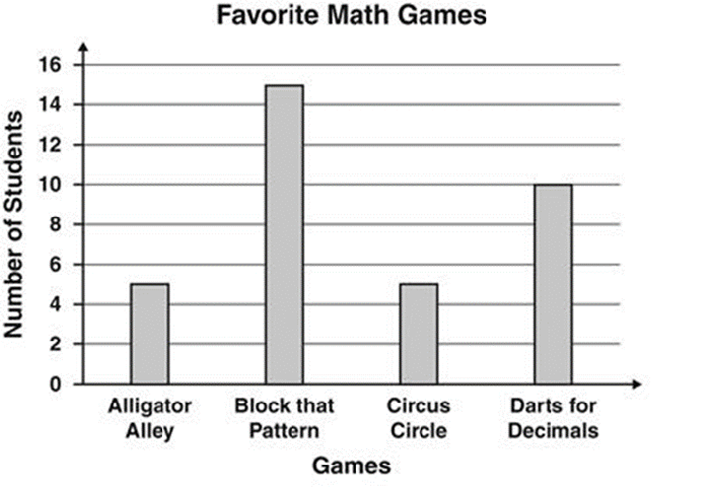
Math Corner-Measurement
Part A
What is the number of students that chose each game?
Part B
What is the total number of students counted in this survey?
Part C
How many more students liked Block That Pattern than Circus Circle?

Slide 34
Math Corner Measurement
Carolyn collected some insects for a science project. The length, in inches, of the insects are listed below.
1/8, ¼, ¼, ½ , ½ , 1/8, ½, ½, 1/8, 1/8, ½, ½
Part A
Make a line plot of the data. Include labels and a title.

Slide 35
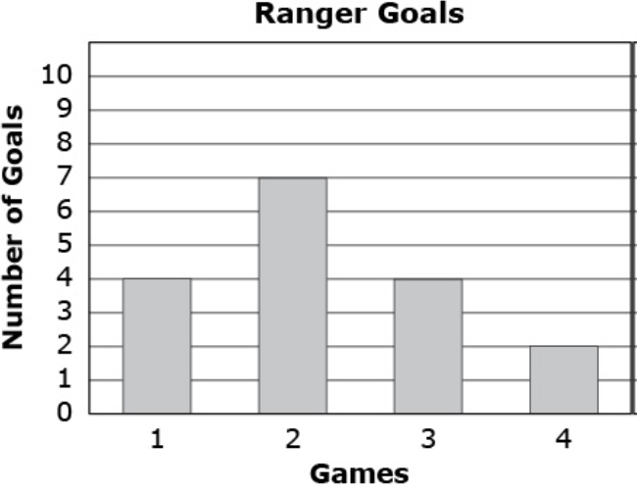
Constructed Response-Measurement
The Rangers played 4 games against the Sliders in
Soccer. The bar graph shows how many goals the
Rangers scored in each game.
Part A
How many goals did the Rangers score in all 4
games? Show your work.
Part B
In the second game, the Sliders scored 1 less goal than the Rangers. How many goals did the Sliders score in Game 2? Show your work.
Part C
The Rangers wanted to score 25 goals in 4 games. How many more goals did the Rangers need to score to reach this? Show your work.

Slide 36
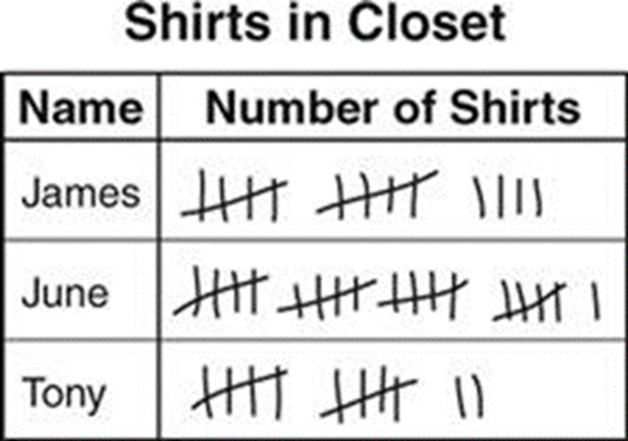
Math Corner-Measurement
Part A
Create a pictograph to represent the tally marks. What is a numeric scale to use for your graph?
Part B
Create a bar graph using the data from the tally marks. What is a numeric scale to use for your graph? Can you use a different one from Part A?
Part C
If each tally mark represented 2 shirts, how many shirts would each student have?

Slide 37
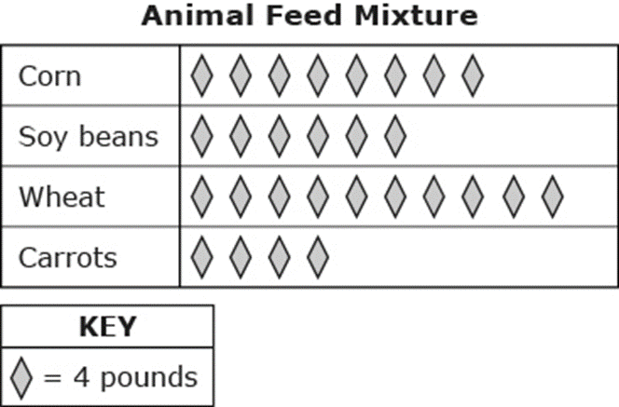
Constructed Response -Measurement
The picture graph shows the amounts of corn, soy beans, wheat, and carrots that a farmer uses to make animal feed.
Part A
What is the total value of each ingredient? How many more pounds of corn does the farmer use than soy beans? Show your work.
Part B
The farmer wants to add 28 pounds of pumpkins to the animal feed. Draw a row of shapes that should be added to the picture graph to show how many pounds of pumpkins are in the mix.
Part C
Create a bar graph using the data from the picture graph.

